Slide 1
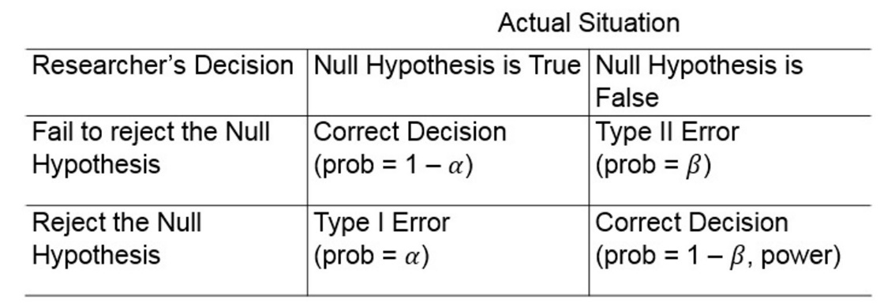
Type I and II Errors
When we make a decision about the null hypothesis there are four possible outcomes (2 correct and 2 incorrect)

Slide 2
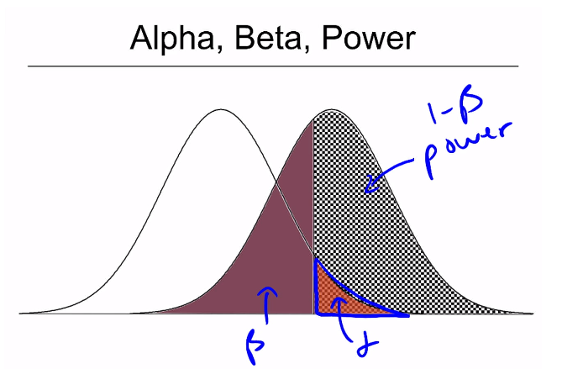

Type I and II Errors, Power
$p\left(\text{Type} \text{I} \text{error}\right)=p\left(\text{rejecting} H_{0} | H_{0} \text{is} \text{true}\right)=α$
$p\left(\text{Type} \text{II} \text{error}\right)=p\left(\text{failing} \text{to} \text{reject} H_{0} | H_{0} \text{is} \text{false}\right)=β$
$\text{Power}=p\left(\text{rejecting} H_{0} | H_{0} \text{is} \text{false}\right)=1−β$

Slide 3
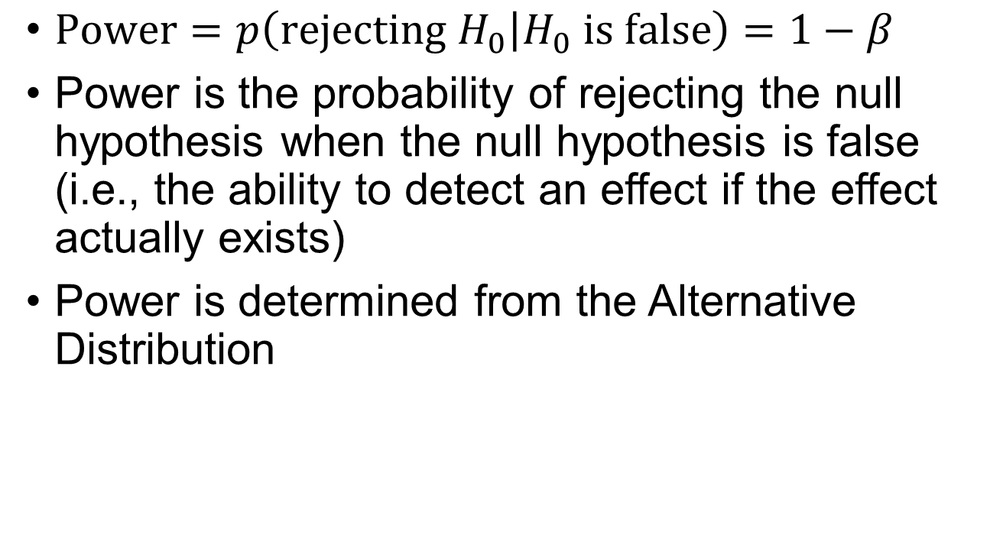
Power
$\text{P}\text{ower}=p\left(\text{rejecting} H_{0} | H_{0} \text{is} \text{false}\right)=1−β$
Power is the probability of rejecting the null hypothesis when the null hypothesis is false (i.e., the ability to detect an effect if the effect actually exists)
Power is determined from the Alternative Distribution

Slide 4
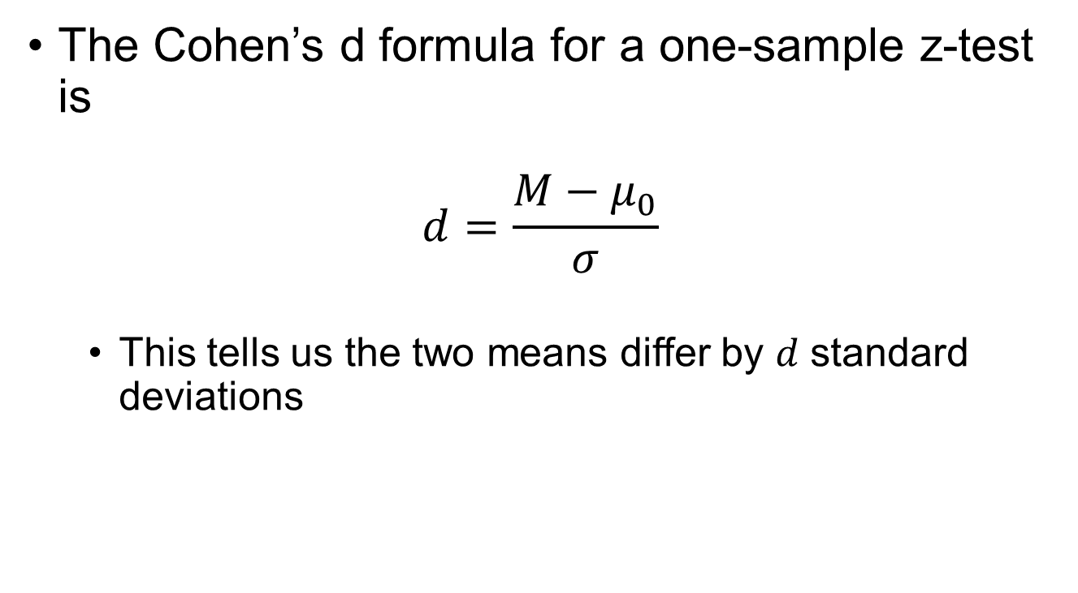
Effect Size
The Cohen’s d formula for a one-sample z-test is
$$d=\frac{M−μ_{0}}{σ}$$
This tells us the two means differ by $d$ standard deviations

Slide 5
Cohen’s d
Cohen’s d interpretation
Verbal description | Effect size (d)
Small | d < .20
Medium | .20 < d < .80
Large | d > .80

Slide 6
One-sample t-test
The z-statistic versus t-statistic
z-statistic:
$$z=\frac{M−μ_{0}}{σ_{M}}=\frac{M−μ_{0}}{\frac{σ}{\sqrt{n}}}$$
t-statistic:
$$t=\frac{M−μ_{0}}{s_{M}}=\frac{M−μ_{0}}{\frac{s}{\sqrt{n}}}$$

Slide 7
Effect Size
The effect size, Cohen’s d, for a one-sample t-test is computed the same as the one-sample z-test except $s$ is used instead of $σ$
$$d=\frac{M−μ_{0}}{s}$$

